Slide 1

Blockchain Contract Fortification: Bytecode Analysis To Check For Smart Contract Vulnerabilities
Title:
Under the Guidance of,
Dr. A. Kavitha
Associate Professor
Dept of CSE
Project by:
Mohammed Abdul Lateef
22011DA802
JNTUHCEH

Slide 2

Agenda
Introduction
Problem Statement
Approach
Results
Conclusion
References

Slide 3
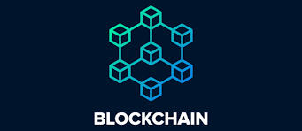
INTRODUCTION:
In today's fast-paced world, traditional methods of handling transactions face numerous challenges.
Slow and costly processes, intermediaries, and lack of transparency are just a few of the pain points.
Fortunately, emerging technologies like smart contracts and blockchain offer innovative solutions.

Slide 4
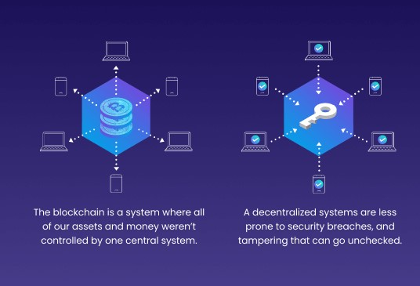

Slide 5
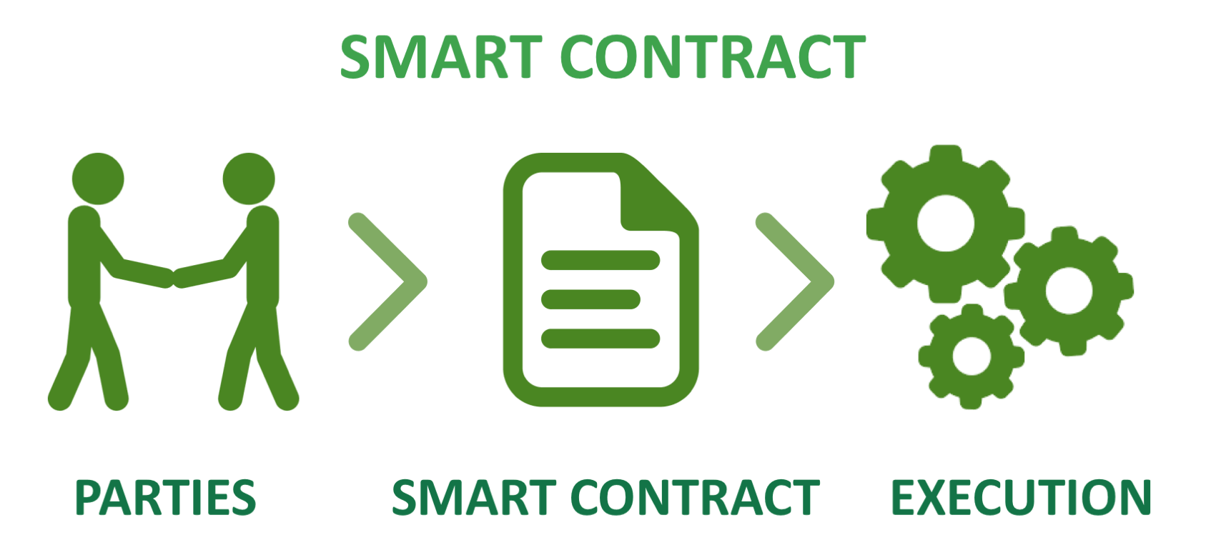
What is
Smart contracts are SELF-EXECUTING AGREEMENTS with predefined conditions written into code.
Automatically execute when the conditions are met.
By combining blockchain's trust and security with automation, smart contracts unlock tremendous potential.

Slide 6
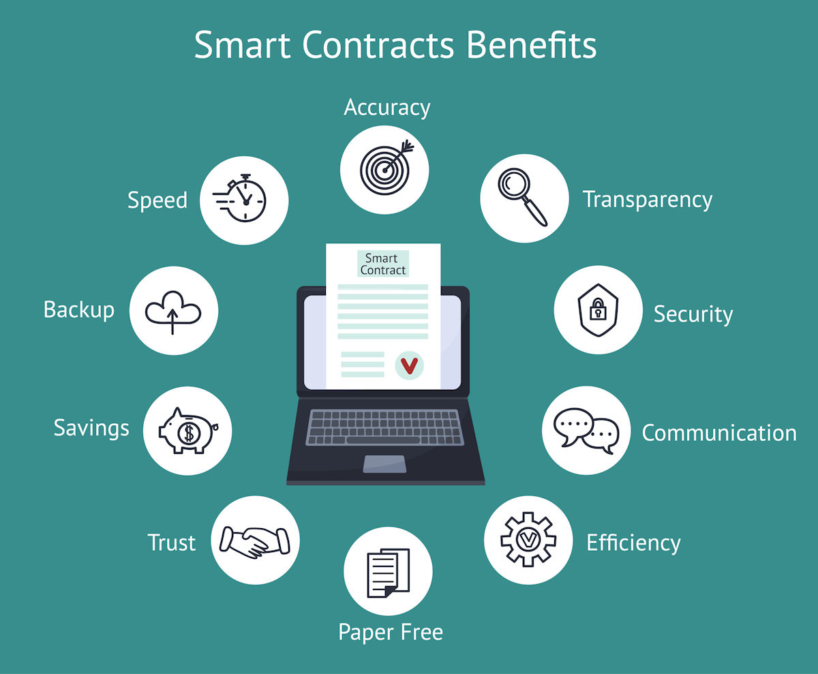

Slide 7
Agenda
Introduction
Problem Statement/Objective
Approach
Result
Conclusion
References

Slide 8
Smart Contract Vunlerability
Blockchain platforms and smart contracts are vulnerable to security breaches.
Security breaches of smart contracts have led to huge financial losses in terms of cryptocurrencies and tokens

Slide 9
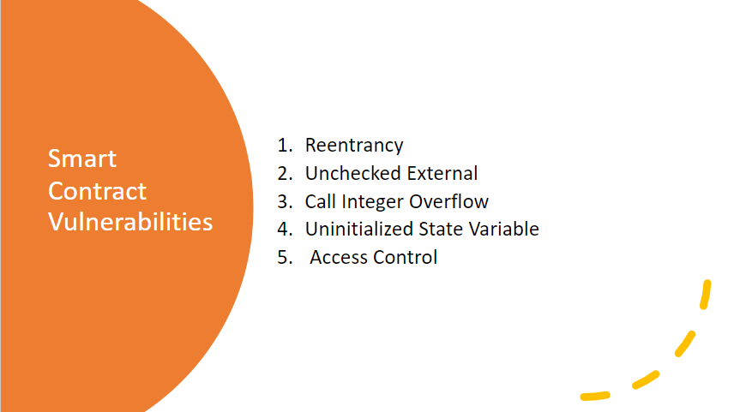

Slide 10
Agenda
Introduction
Problem Statement
Approach
Results
Conclusion
References

Slide 11
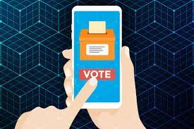
Case study applied and considered:
E-voting
function increase() external { ++counter; }

Slide 12
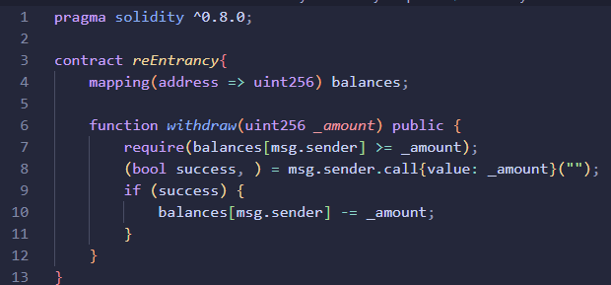
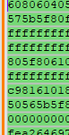
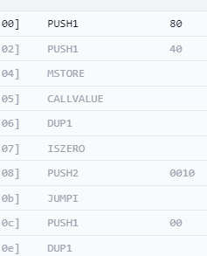
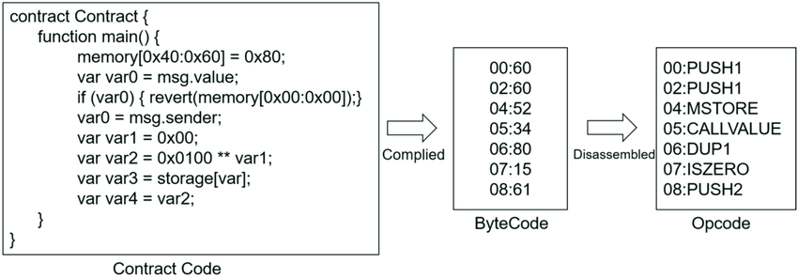
Breakdown Of High Level Smart Contract Code

Slide 13

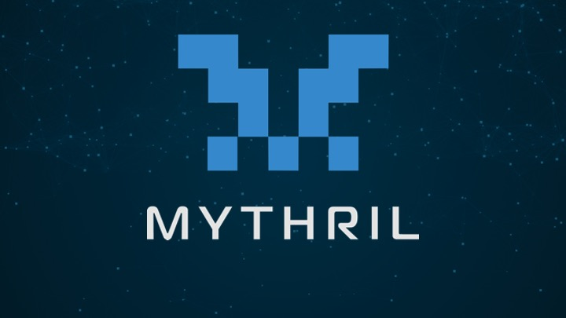


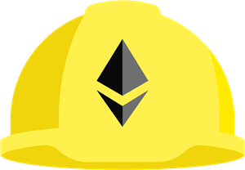

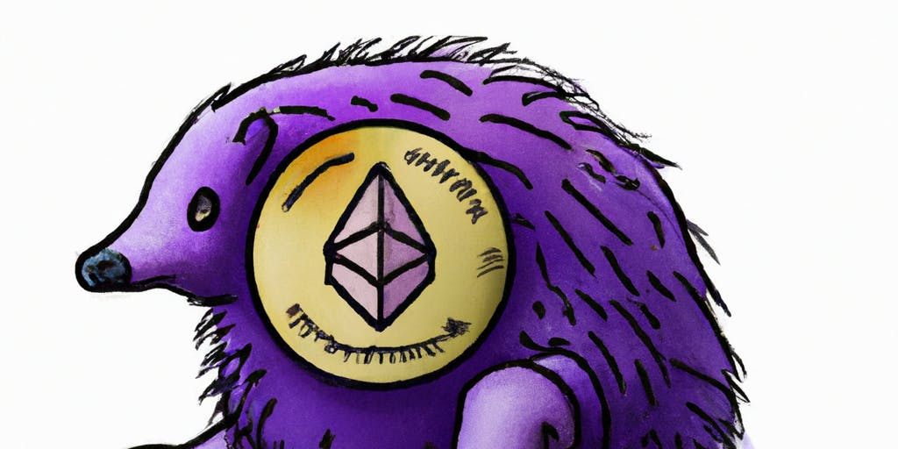
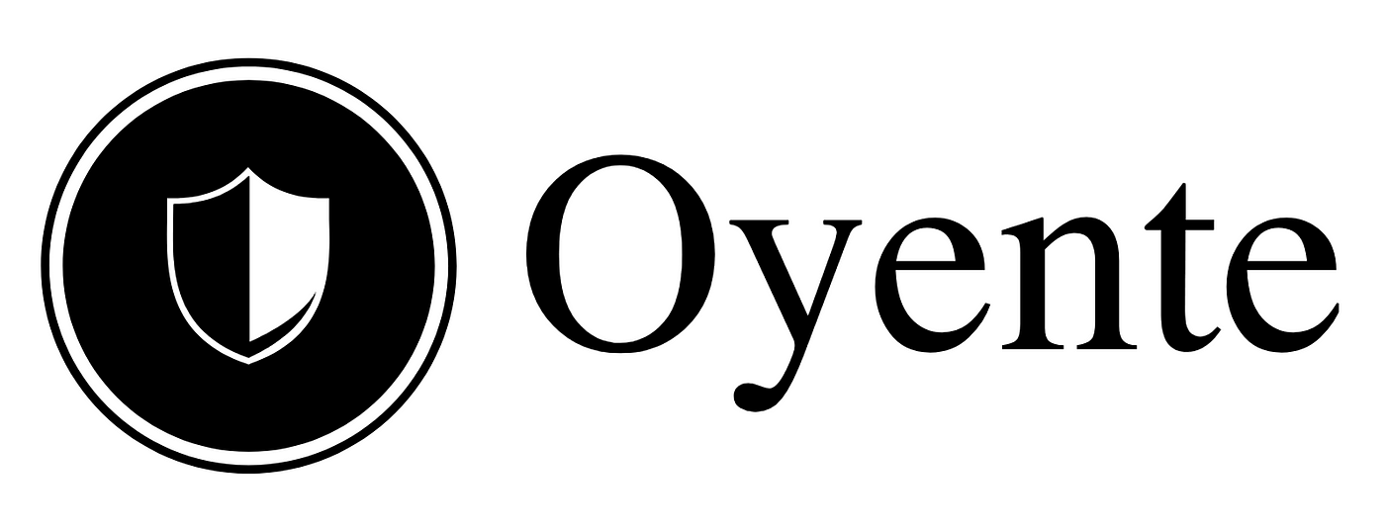


Vulnerability Check Tools
Other Tools and Software

Slide 14
Agenda
Introduction
Problem Statement
Approach
Results
Conclusion
References

Slide 15
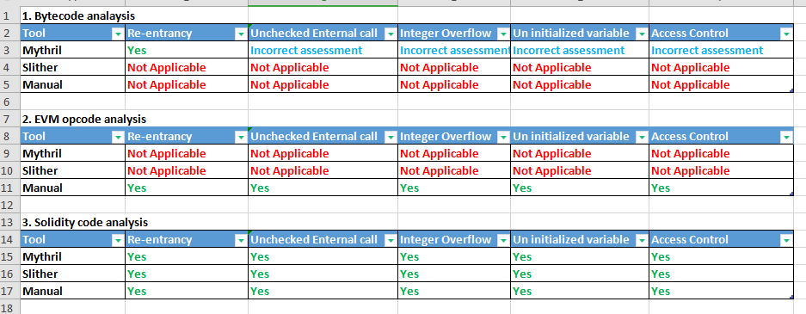
Figure 1: Bytecode and Solidity Code analysis by tools

Slide 16
Agenda
Introduction
Problem Statement
Approach
Results
Conclusion
References

Slide 17
Concluding statement…
The approach combines automated analysis through tools and manual examination for inspection of bytecode.
Overall, the key focus is inclined to have a concise view of what vulnerabilities in smart contract can be checked through bytecode analysis.

Slide 18
Agenda
Introduction
Problem Statement
Approach
Conclusion
References

Slide 19
References
1 . A survey on smart contract vulnerabilities: Data sources, detection and repair,
Information and Software Technology,
Volume 159, 2023,107221, ISSN 0950-5849,
* https://doi.org/10.1016/j.infsof.2023.107221
(https://www.sciencedirect.com/science/article/pii/S0950584923000757)
2. https://medium.com/@alexanderzammit_97283/smart-contract-deployment-internals-cc9cca4f4ae6

Slide 20


